Slide 1
Exploring Neighborhoods of Mumbai for Starting Café
Applied Data Science Capstone Project
By: Abhijeet Mukherjee
Date: March 22, 2021

Slide 2
Introduction
Mumbai is one of the busiest metropolitan in India, being the financial capital and one of the densely populated City. Due to multiple iconic spots, Mumbai is a major tourist attraction every year. I have been working in Mumbai for a while now and have unique experience with the neighborhoods. It is one of the major IT hub and everyday thousands of professionals prefer business meetups in Café. This is a everyday dilemma faced by IT professional like myself to actually find a place to carry out small tasks like sending mails, making calls without background disturbance or grabbing a coffee between a hectic day. Thus, the aim of this project is to study the neighborhoods in Mumbai to determine possible locations for starting a Café . This project can be useful for business owners and entrepreneurs who are looking to invest in a Café in Mumbai. The main objective of this project is to carefully analyze appropriate data and find recommendations for the stakeholders.

Slide 3
Data Collection
The following data was collected for this project:
Neighborhood data of Mumbai from https://en.wikipedia.org/wiki/List_of_neighborhoods_in_Mumbai
Geographical coordinates of Mumbai and all neighborhoods in Mumbai using GeoPy and Geocoder libraries in python
Venue data for all neighborhoods in Mumbai using Foursquare API

Slide 4
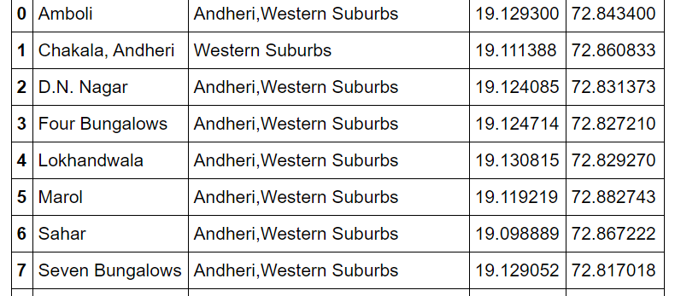
Dataset for Mumbai Neighborhoods

Slide 5
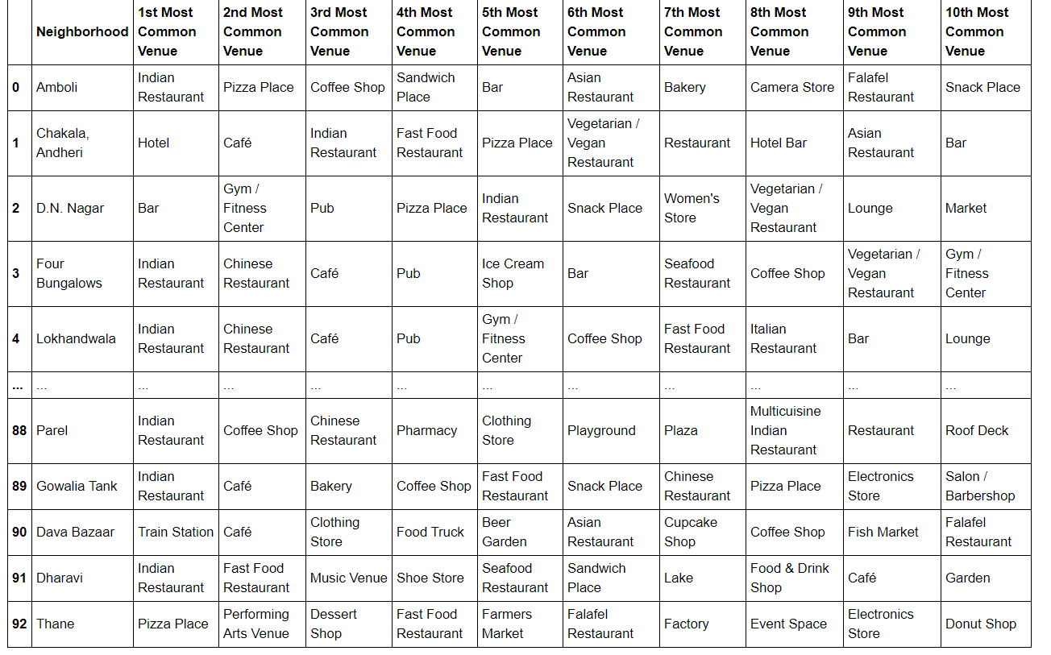
Dataset for Top 10 Most Common Venues

Slide 6
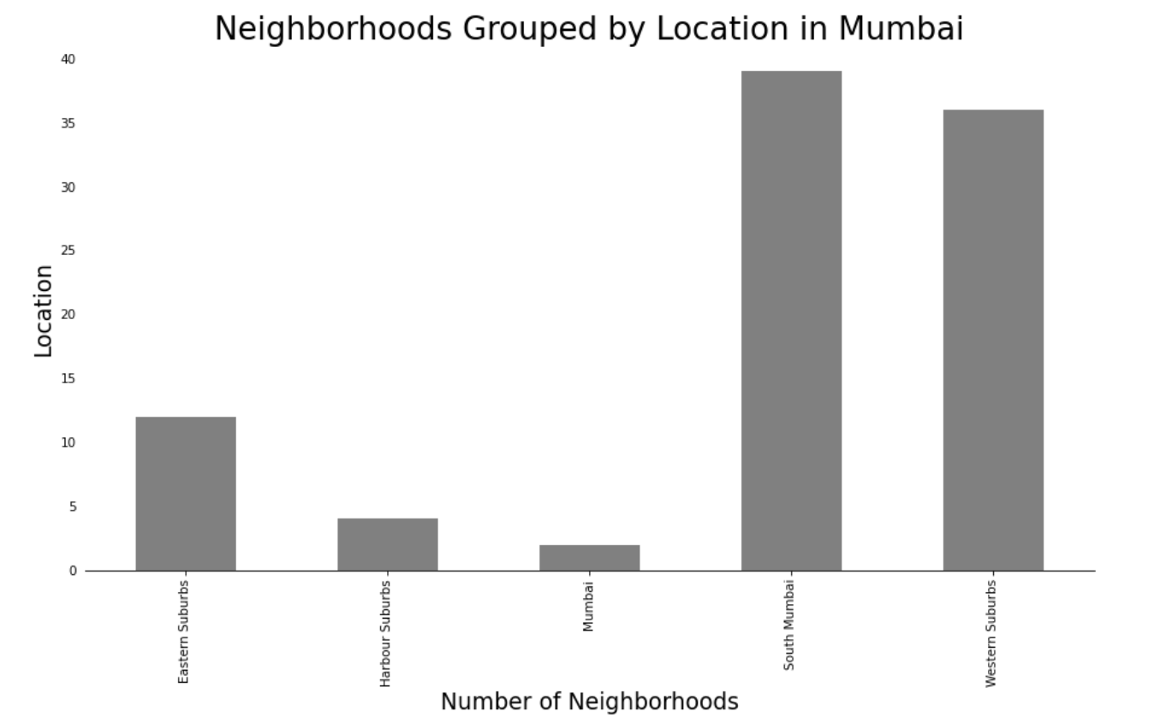
Methodology
Data Visualization
• Mumbai neighborhoods data was plotted for providing a better understanding
• The graph alongside depicts the number of neighborhoods in each location of Mumbai
• All neighborhoods on the outskirts of the city have been grouped as “Mumbai”
• Western Suburbs and South Mumbai contain the highest number of neighborhoods

Slide 7
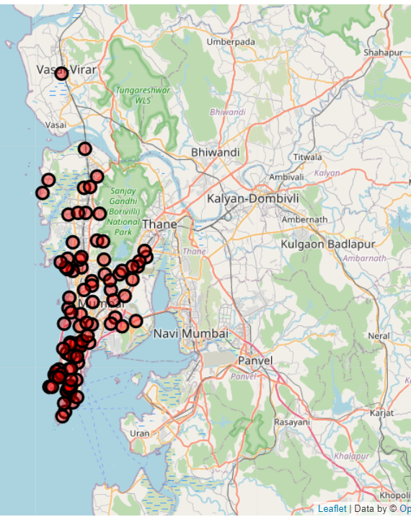
Continued…
Data Visualization
The Folium library in python was used to visualize the spread of all neighborhoods across Mumbai

Slide 8
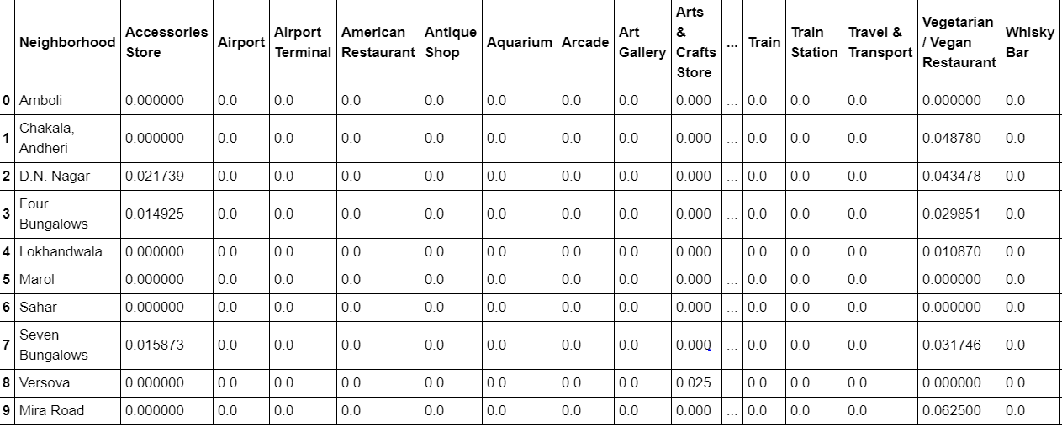
One-hot Encoding
One-hot Encoding was used to encode venue categories to numeric values with 1 if a venue belongs to a category and 0 if a venue does not belong to a category for all neighborhoods • The average is then taken for all venue categories in a neighborhood to produce the data frame shown

Slide 9
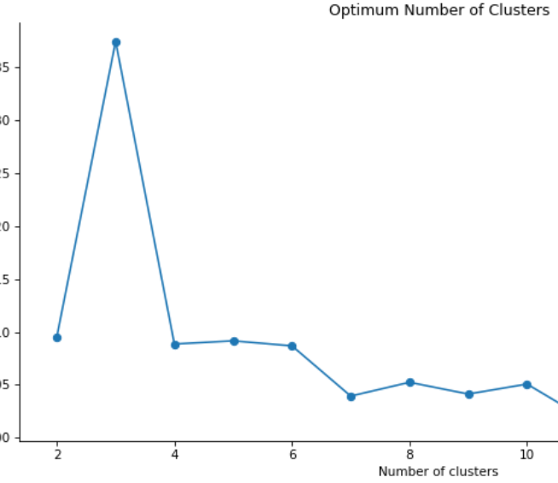
Unsupervised Learning Model
KMeans clustering was used to cluster neighborhoods in Mumbai based on venue categories
The plot shows a maximum Silhouette Score for 5 clusters and thus the n_clusters parameter in KMeans clustering was set to 5

Slide 10
Results
Each neighborhood received a cluster label based on clustering by the KMeans algorithm
The Cluster Label column along with the Location, Latitude, and Longitude columns were added to the top 10 most common venues dataframe to provide the final results
This dataframe is shown on the next slide

Slide 11
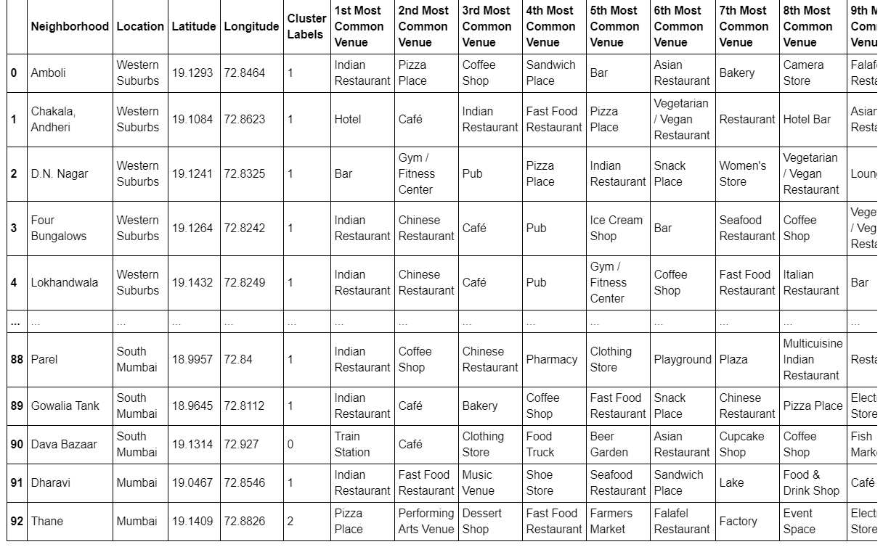
Clustered Neighbourhood

Slide 12
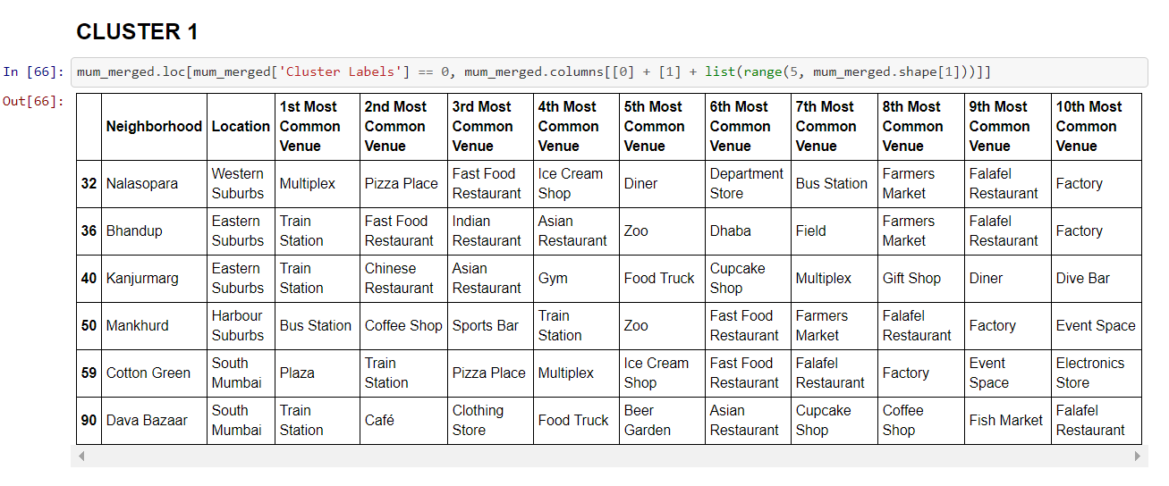
Cluster 1

Slide 13
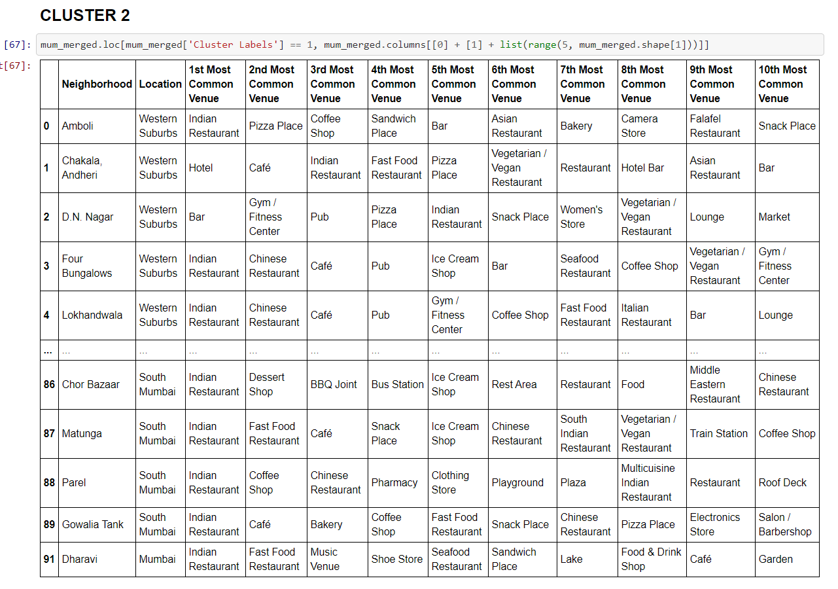
Cluster 2

Slide 14
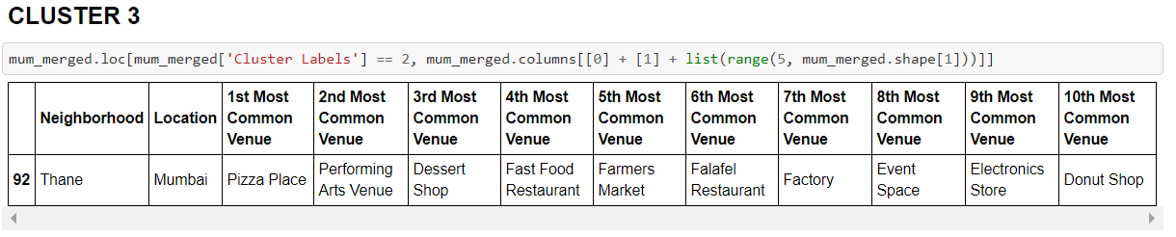
Cluster 3

Slide 15
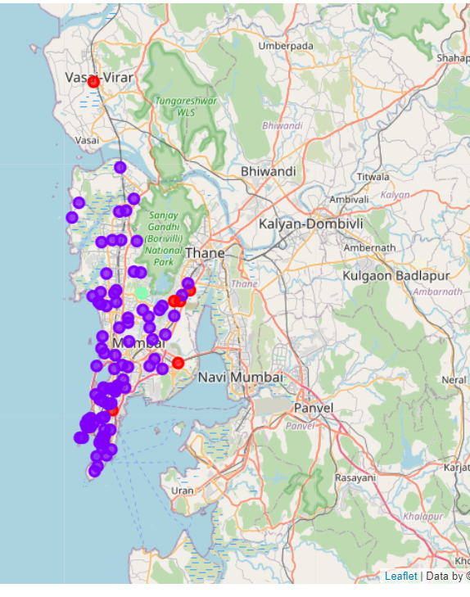
Visualization of neighborhood clusters was done using Folium in python
Different clusters correspond to different colors

Slide 16
Discussion
By analyzing the three clusters obtained we can see that some of the clusters are more Cafe, whereas, other clusters are less suited. Neighborhoods in clusters 1 and 3 contain a small percentage of restaurants, hotels, cafe and pubs in their top 10 common venues. These clusters contain a higher degree of other venues like train station, bus station, fish market, gym, performing arts venue and smoke shop, to name a few. Thus, they are not well suited for opening a new cafe. On the other hand, neighborhoods in cluster 2 contain a much higher degree of restaurants, hotels, multiplex, cafes, bars and other food joints. Thus, the neighborhoods in this clusters would be well suited for opening a new restaurant.
Most neighborhoods in cluster 2 seem to have Cafe as their top most common venue; however, on careful analysis we can see that neighborhoods in cluster 2 also contain other venues like soccer field, flea market, smoke shop, gym, train station, dance studio, music store, cosmetics shop and so on. Thus, it is recommended that the new Cafe can be opened in the neighborhoods belonging to cluster 2.

Slide 17
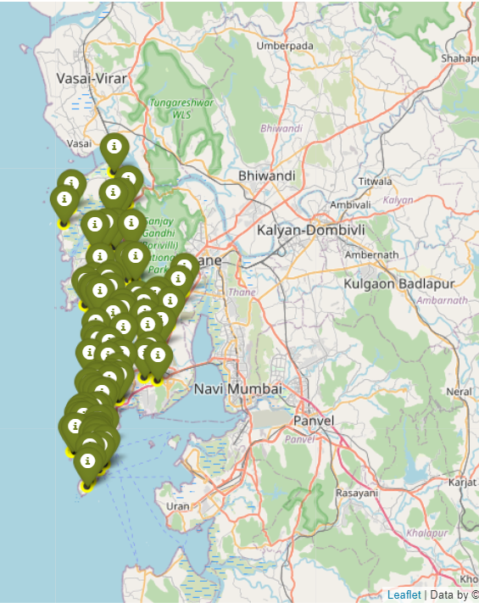
Plotting final results using Folium library in python

Slide 18
Conclusion
In this project, the neighborhoods in Mumbai, India have been successfully analyzed for determining which would be the best neighborhoods for opening a new restaurant
Based on the analysis carried out, neighborhoods in cluster 1 are recommended as locations for the new restaurant
The stakeholders and investors can further tune this by considering various other factors like transport, legal requirements, and costs associated which were out of the scope for this project and thus were not considered

